Slide 1
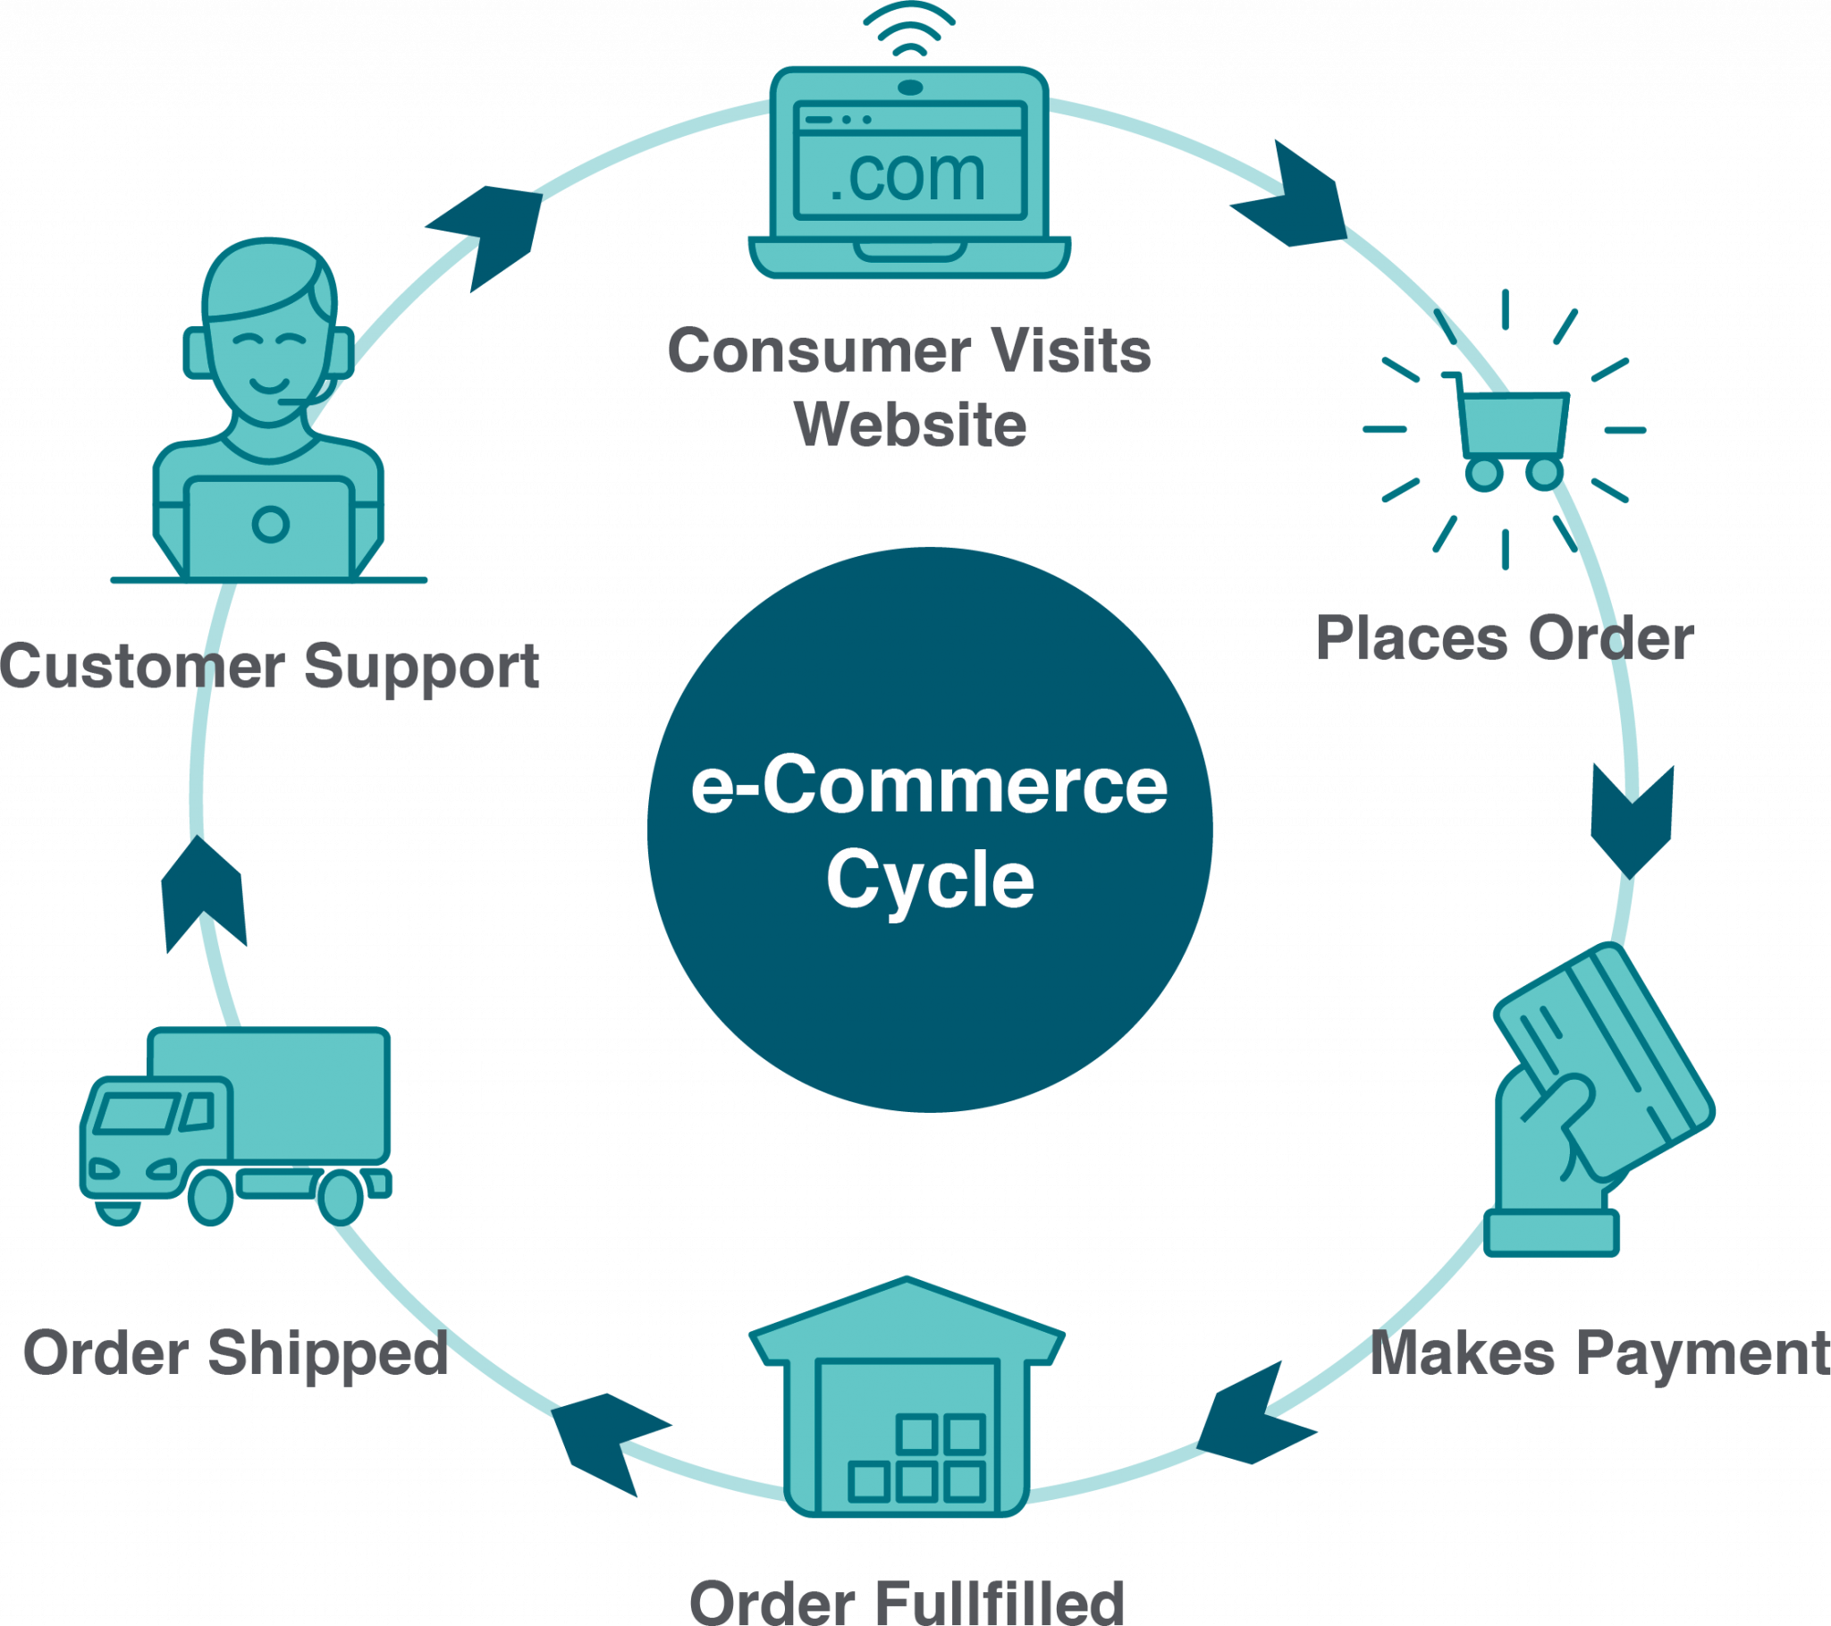
E-Commerce Company Analytics Report
Tech Stack Used – SQL
Presented by – Ashirwad Das

Slide 2
Business Context:
Customer Insights: Understanding our customer base to tailor marketing strategies.
Product Analysis: Evaluating product performance to inform stock and sales strategies.
Sales Optimization: Analyzing sales data to identify trends, opportunities, and areas of improvement.
Inventory Management: Managing stock levels to ensure product availability while minimizing excess inventory.
This Schema includes four tables named Customers, Products, Orders and OrderDetails and all are explained below.
Dataset Dictionary
Customers Table: customer_id (INT), name(VARCHAR),location(VARCHAR).
Products Table: product_id (INT), name(VARCHAR), category(VARCHAR),price(INT).
Orders Table: order_id (INT), order_date (INT), customer_id (INT), total_amount (INT).
OrderDetails: order_id (INT), product_id (INT), quantity (INT), price_per_unit (INT).

Slide 3
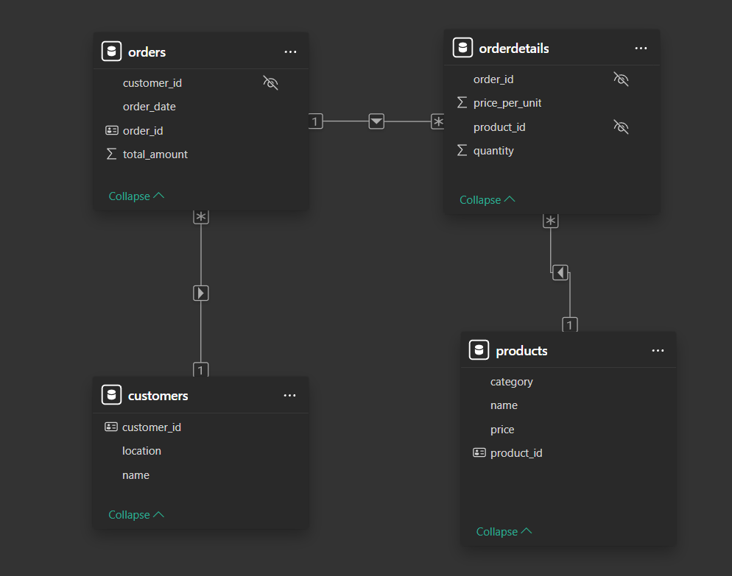
Database Schema :-

Slide 4
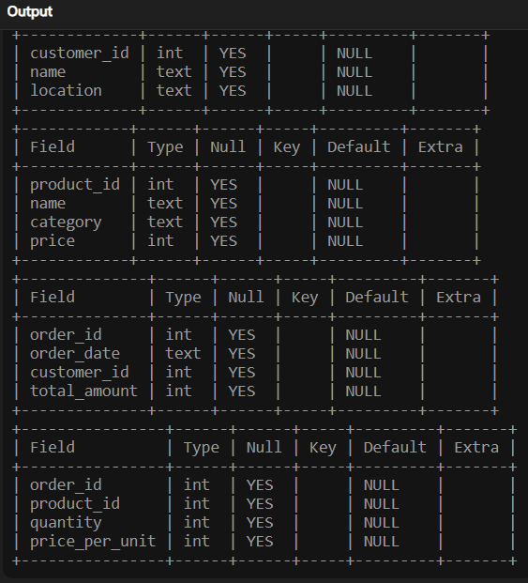
You can analyze all the tables by describing their contents.
Task: Describe the Tables:
1.Customers 2. Products 3. Orders 4. OrderDetails
Query:-
DESCRIBE Customers;
DESCRIBE products;
DESC orders;
DESC orderdetails;
Insights:
I have analyzed the data by describing the table.

Slide 5
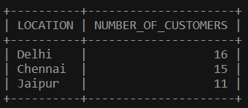
Identify the top 3 cities with the highest number of customers to determine key markets for targeted marketing and logistic optimization.
Query:-SELECT location, COUNT(*) AS number_of_customers
FROM customers
GROUP BY
location
ORDER BY
number_of_customers
DESC
LIMIT 3;
Insights:
Delhi, Chennai & Jaipur have the highest number of customers.
Output:-
Suggestions:
Delhi, Chennai & Jaipur are key markets for target marketing.
Logistic optimization should be maintained in these locations.

Slide 6
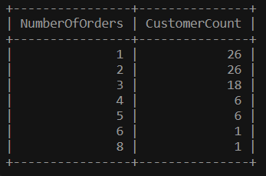
Determine the distribution of customers by the number of orders placed.
Query:- WITH CustomerSegment AS (
SELECT Customer_ID,
Count(Order_ID) AS
NumberOfOrders
FROM Orders
GROUP BY Customer_ID
)
SELECT NumberOfOrders,
COUNT(Customer_ID) AS
CustomerCount
FROM CustomerSegment
GROUP BY NumberOfOrders
ORDER BY NumberOfOrders;
Insights:
As the number of order increases, the customer count decreases.
Most customers are occasional shoppers(60% approx.).
1/3 of our customers are one time buyer.
Output:-
Suggestions:
Focus on converting one-time buyer into occasional shoppers.
Implement new marketing strategies to convert occasional buyers into regular customers.

Slide 7
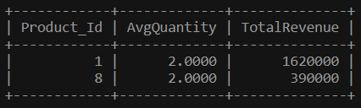
Identify products where the average purchase quantity per order is 2 but with a high total revenue, suggesting premium product trends.
Query:-
SELECT Product_Id,
AVG(quantity) AS
AvgQuantity,
SUM(
quantity*Price_per_unit)
AS TotalRevenue
FROM OrderDetails
GROUP BY Product_Id
HAVING AvgQuantity = 2
ORDER BY TotalRevenue
DESC ;
Output:-
Insights:
Product 1 has the highest revenue among products with an average purchase quantity of two.
Product 8 follows with a revenue of $39000.
Suggestions:
Focus on Product 1 & 8, since they are favorite to customers.

Slide 8
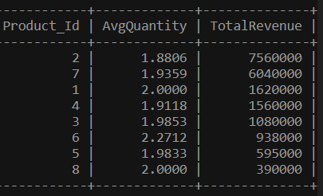
Identify products where the average purchase quantity per order is 2 but with a high total revenue, suggesting premium product trends.
Query:-
SELECT Product_Id,
AVG(quantity) AS
AvgQuantity,
SUM(
quantity*Price_per_unit)
AS TotalRevenue
FROM OrderDetails
GROUP BY Product_Id
ORDER BY TotalRevenue
DESC ;
Output:-
Insights:
Product 2 has the highest revenue among products ($ 75,60,000).
Product 7 follows Product 2 with a revenue of $60,40,000.
Suggestions:
Focus on promoting Product 2 & 7 to generate highest revenue.

Slide 9
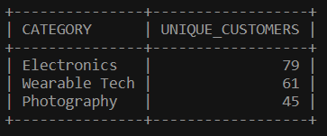
For each product category, calculate the unique number of customers purchasing from it. This will help understand which categories have wider appeal across the customer base.
Query:-
WITH OrderCategories AS (
SELECT DISTINCT O.order_id,
O.customer_id, P.category
FROM Orders O
JOIN OrderDetails OD
ON O.Order_ID = OD.order_id
JOIN Products P
ON OD.product_id = P.product_id
)
SELECT category,
COUNT(DISTINCT customer_id) AS unique_customers
FROM OrderCategories
GROUP BY category
ORDER BY unique_customers
DESC;
Insights:
Electronics has a wider appeal across the customer base.
Suggestions:
Electronics Category needs more focus as it is in high demand.
Output:-

Slide 10
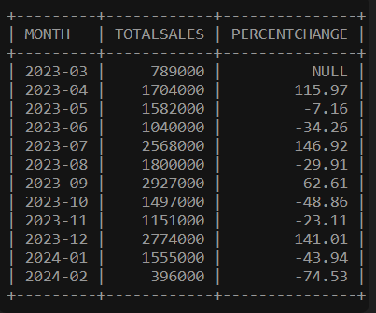
Analyze the month-on-month percentage change in total sales to identify growth trends.
Output:-
Query:-
WITH monthly_sales AS(
SELECT DATE_FORMAT(order_date,"%Y-%m") AS Month,
SUM(total_amount) AS TotalSales
FROM Orders
GROUP BY Month )
SELECT Month, TotalSales,
ROUND((TotalSales - LAG(TotalSales) OVER (ORDER BY Month))*100/
LAG(TotalSales) OVER (ORDER BY Month),2) AS percentchange
FROM monthly_sales
ORDER BY Month;
Insights:
Sales were 2.5X in July, Dec comparing to June/Nov.
In Feb 24 sales experienced the largest decline.
Suggestions:
Create new offers in Feb to boost sales.

Slide 11
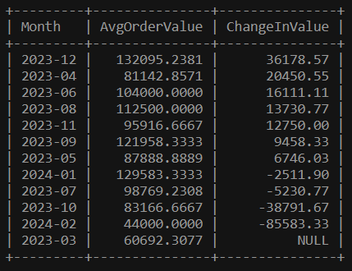
Examine how the average order value changes month-on-month. Insights can guide pricing and promotional strategies to enhance order value.
Query:-
WITH Avg_Order AS(
SELECT
DATE_FORMAT(Order_Date, '%Y-%m') AS Month,
AVG(total_amount) AS AvgOrderValue
from Orders
GROUP BY Month),
M_O_M AS(
SELECT Month,
AvgOrderValue,
LAG(AvgOrderValue) OVER (ORDER BY Month)
AS PreviousMonthValue
FROM Avg_Order)
SELECT Month,
AvgOrderValue,
ROUND((AvgOrderValue- PreviousMonthValue),2)
AS ChangeInValue
FROM M_O_M
ORDER by ChangeInValue DESC;
Insights:
December has the highest change in average order value.
Output:-

Slide 12
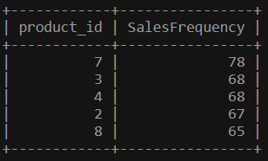
Based on sales data, identify products with the fastest turnover rates, suggesting high demand and the need for frequent restocking.
Query:-
SELECT
product_id,
COUNT(ORDER_ID)
AS SalesFrequency
FROM orderdetails
GROUP BY product_id
ORDER BY SalesFrequency
DESC
LIMIT 5;
Insights:
Product 7 has the fastest turnover rates.
Followed by Product 3,4,2,8 respectively.
Suggestions:
Products 2,3,4,7,8 needed frequent restocking as they are on high demand.
Output:-
Note :-
Since there is a limit of 5, the output format does not contain all the rows present in the return table

Slide 13
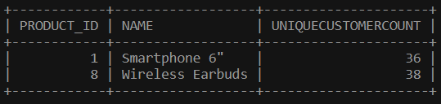
List products purchased by less than 40% of the customer base, indicating potential mismatches between inventory and customer interest.
Query:-
WITH Totalcustomer AS(
SELECT COUNT(DISTINCT customer_id )
AS Total_customer_count
FROM Customers),
TotalProduct AS (
SELECT P.product_id, P.name,
COUNT(DISTINCT O. customer_id )
AS CustomerCount
FROM Orders O
JOIN OrderDetails OD
ON O.order_id = OD.order_id
JOIN Products P ON
OD.product_id = P.product_id
GROUP BY P.product_id, P.name
)
SELECT
TP.product_id,
TP.name,
ROUND(TP.Customercount*100/TC. Total_customer_count)
AS UniqueCustomerCount
FROM TotalProduct TP
CROSS JOIN Totalcustomer TC
WHERE CustomerCount < Total_customer_count * 0.4
ORDER BY UniqueCustomerCount ASC;
Insights:
Wireless Earbuds and Smartphone 6” are the low engagement products with less than 40% of the customer base.
Suggestions:
Implement targeted marketing campaigns to raise awareness and interest.
Output:-

Slide 14
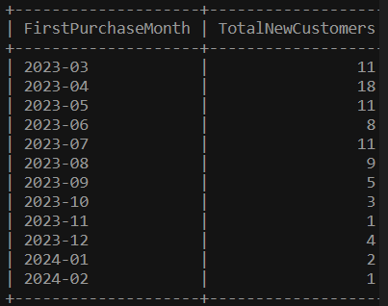
Evaluate the month-on-month growth rate in the customer base to understand the effectiveness of marketing campaigns and market expansion efforts.
Output:-
Query:-
WITH FirstPurchase AS (
SELECT
CUSTOMER_ID,
DATE_FORMAT(MIN(ORDER_DATE),
'%Y-%m') AS FirstPurchaseMonth
FROM ORDERS
GROUP BY CUSTOMER_ID
)
SELECT
FirstPurchaseMonth,
COUNT(*) AS TotalNewCustomers
FROM FirstPurchase
GROUP BY FirstPurchaseMonth
ORDER BY FirstPurchaseMonth;
Insights:
The downward trend implies that marketing campaign are not much effective.

Slide 15
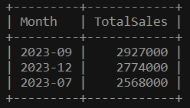
Identify the months with the highest sales volume, aiding in planning for stock levels, marketing efforts, and staffing in anticipation of peak demand periods.
Query:-
SELECT
DATE_FORMAT(order_date, '%Y-%m') AS Month,
SUM(total_amount) AS TotalSales
FROM orders
GROUP BY Month
ORDER BY TotalSales DESC
LIMIT 3;
Output:-
Insights:
September month has the highest sales.
Followed by December and July .
September to December is the peak demand period.
Suggestions:
From September to December major restocking of products and increased staff is required.

Slide 16
Key Insights & Suggestions Summary
Key Insights :-
Delhi, Chennai & Jaipur have the highest number of customers.
60% (approx.) of our customers are occasional shoppers .
Electronics has a wider appeal across the customer base (43%).
Product 7, 3,4 has the fastest turnover rates.
Wireless Earbuds and Smartphone 6” are the low engagement products.
September to December is the peak demand period.
Suggestions :-
Delhi, Chennai & Jaipur are key markets for target marketing.
Focus on converting one-time buyer into occasional shoppers.
Electronics Category needs more focus as it is in high demand.
Products 2,3,4,7,8 needed frequent restocking as they are on high demand.
Implement targeted marketing campaigns to raise awareness and interest.
From September to December major restocking of products and increased staff is required.
END
“Data without action is just potential. Let's turn insights into impact.”

